Slide 1
How to Do HW 1
Recording and Plotting GPS Data from Your Phone
ME 452 – Vehicle Dynamics, Fall 2026

Slide 2
Collect some data!

Slide 3
First step: install the MATLAB app on your phone
(from https://www.mathworks.com/help/matlabmobile/ug/install-matlab-mobile-on-your-device.html )
Install MATLAB Mobile on Your Device: The MATLAB® Mobile™ app is available in the Apple App Store® and in Google Play®.
To download the MATLAB Mobile app on your device:
Start the App Store or Google Play app on your device.
Search the store using the term MATLAB Mobile.
To begin free installation of the app onto your device:
  On Android devices: Tap Install
  On Apple devices: Tap the download icon. In some cases, the iTunes application might request your password to complete the transaction.
When the installation is complete, you can tap Open to start MATLAB Mobile on your device.
Alternatively, for Apple devices you can access the App Store from iTunes software on your computer.
Sign In and Setup
Tap Continue when you open the app.
Sign in with your MathWorks Account or create a new one.
Link a valid MATLAB license or active trial to use full features, or use the free cloud storage option. [1, 2]

Slide 4
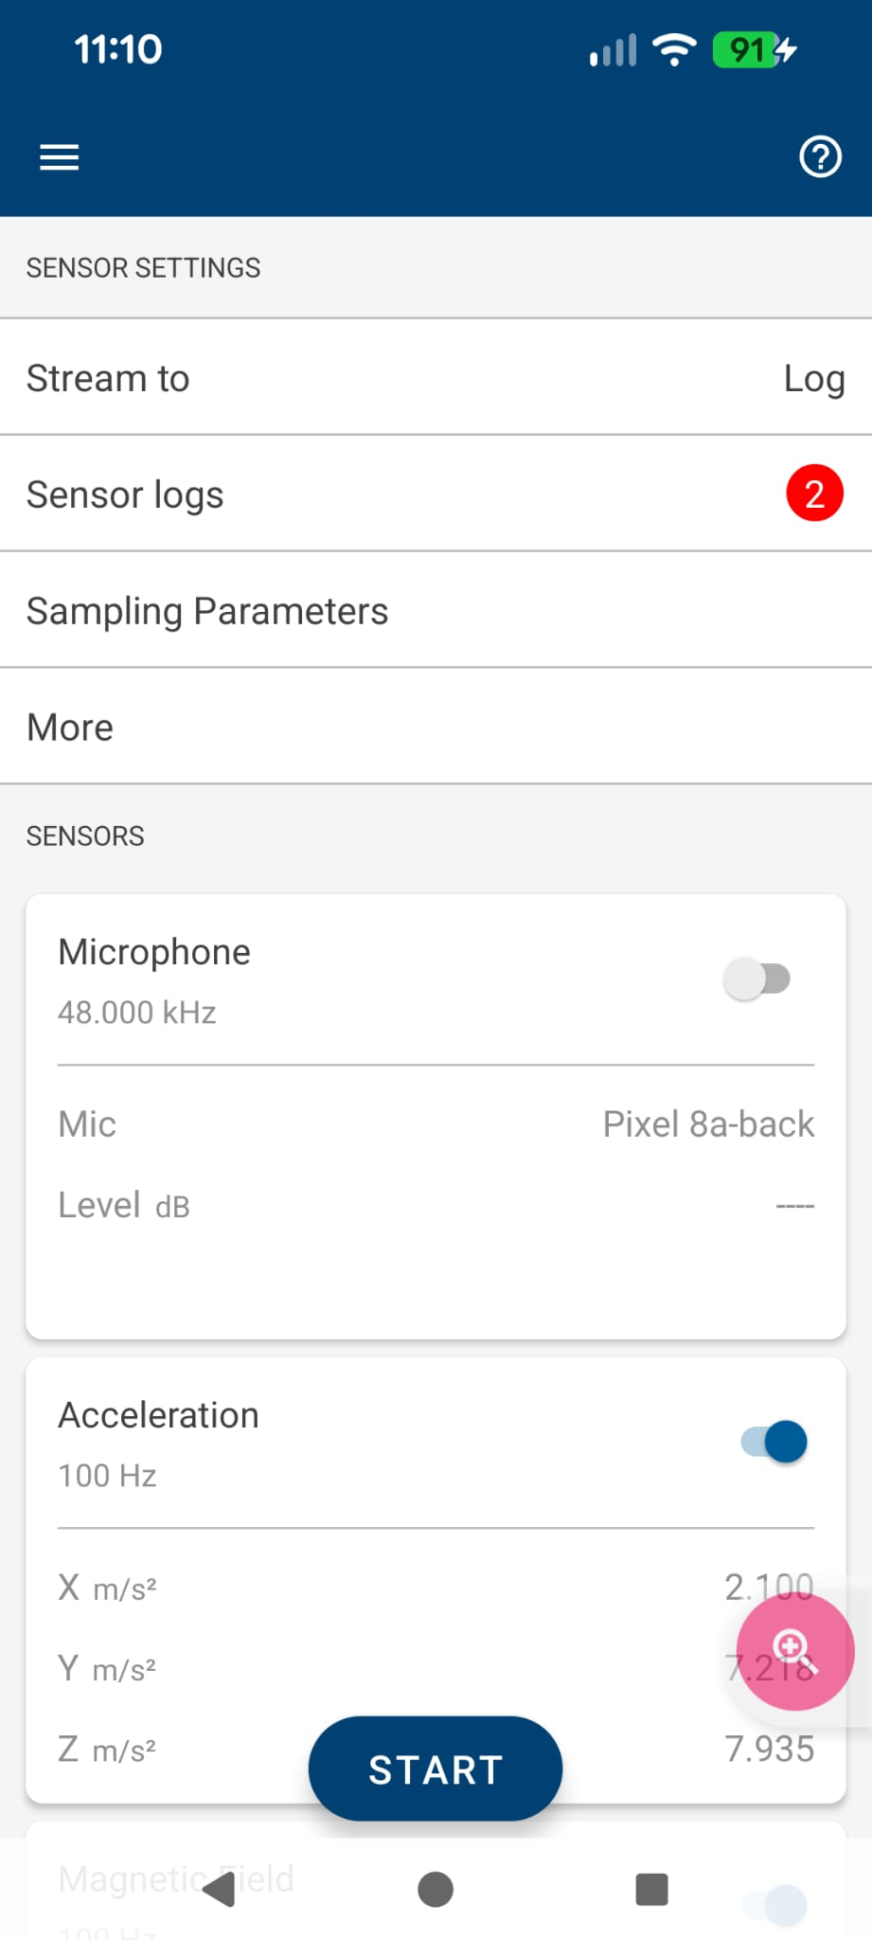
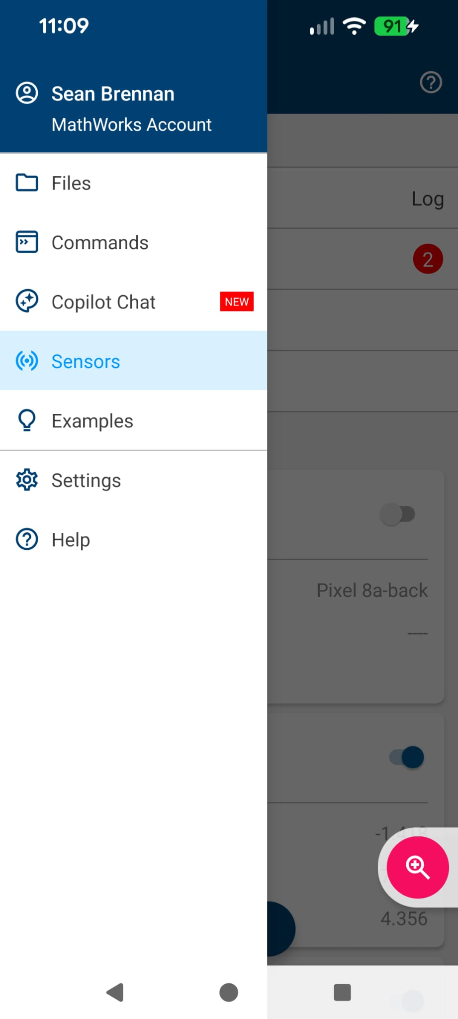
Next, record data. Open up the sensors panel via the drop-down menu:

Slide 5
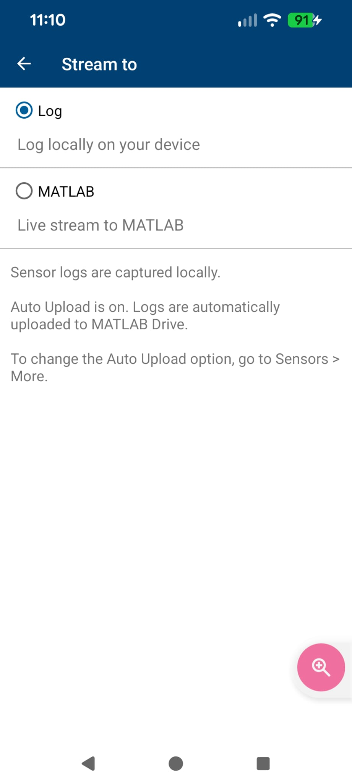
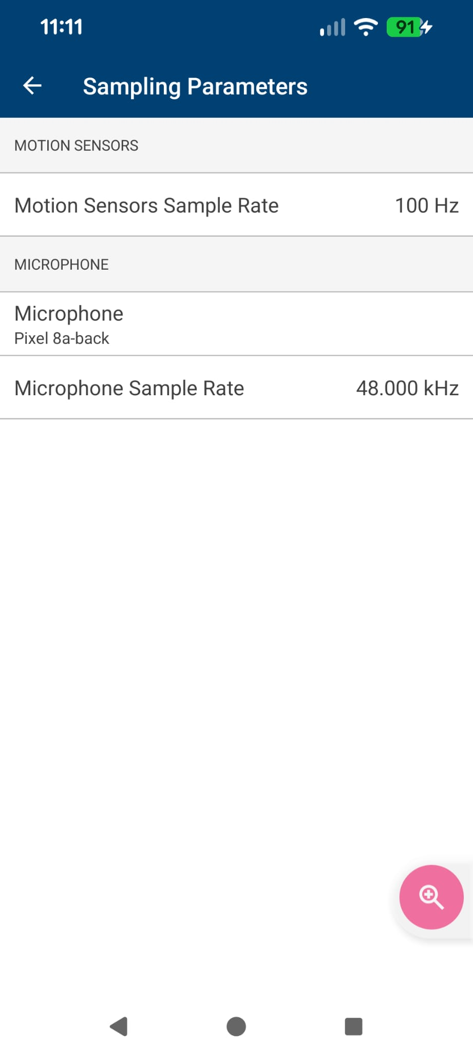
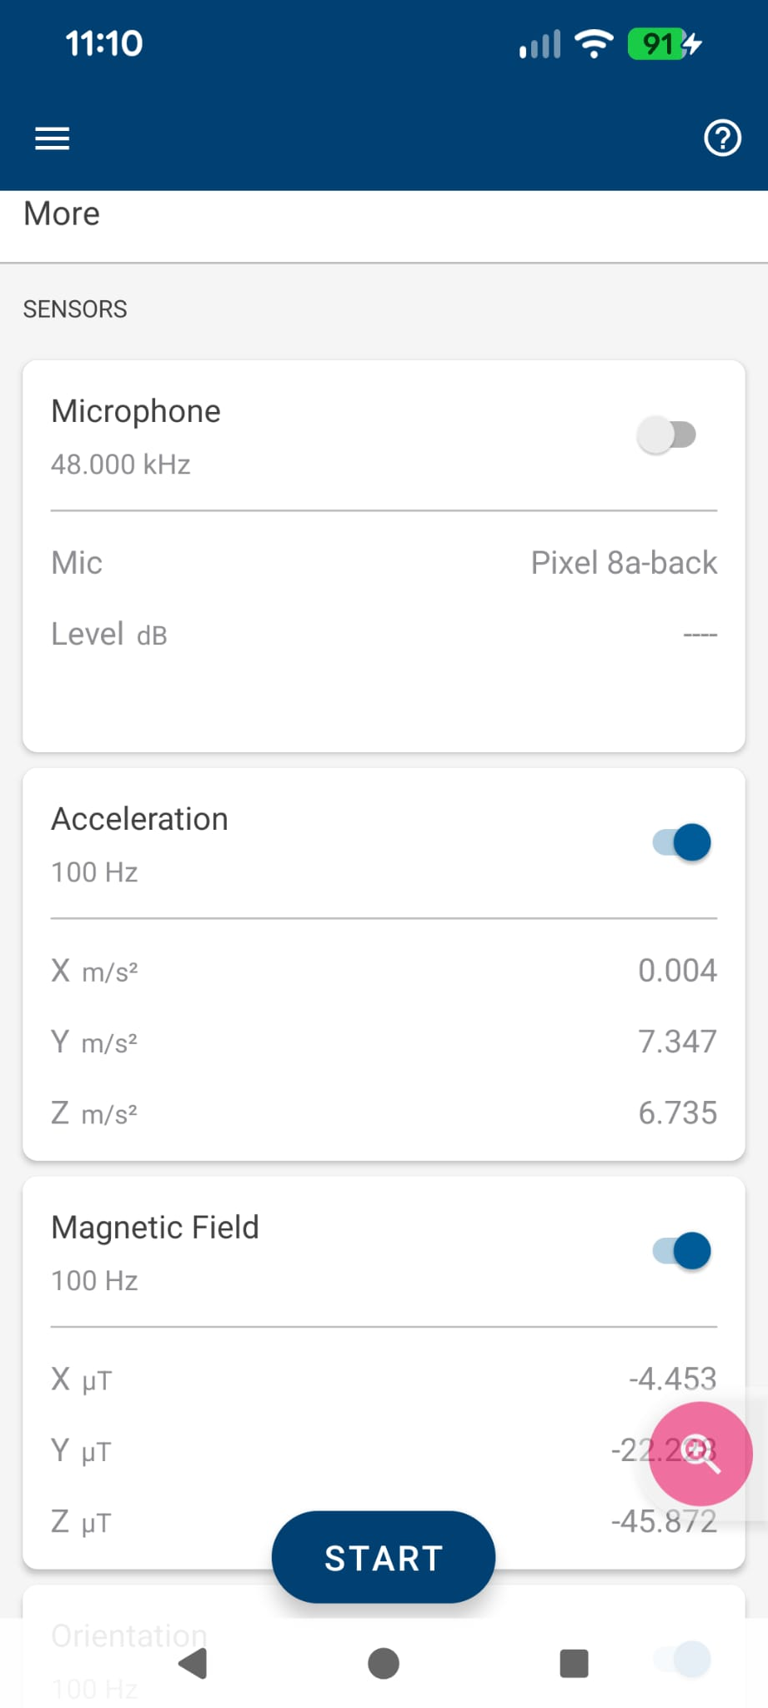
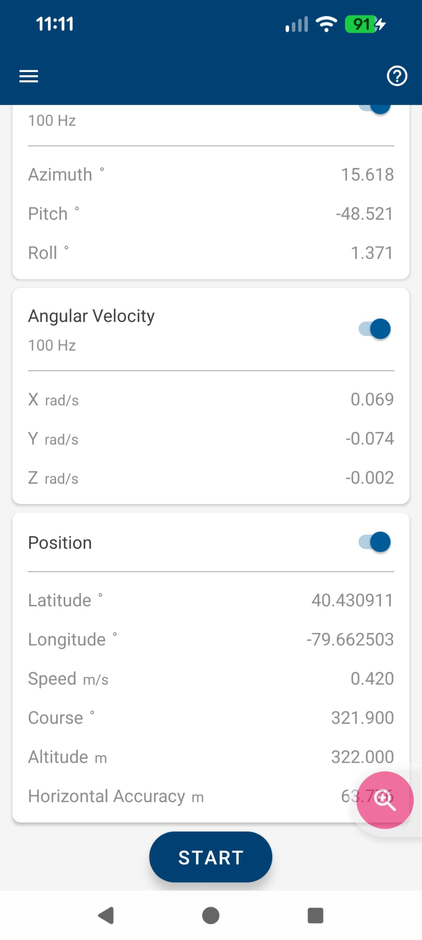
Make sure the Stream-to is set to “Log”. In the “Sampling Parameters”, set the speed to 100Hz (fastest possible), and turn on all sensors except microphone.

Slide 6
When you are ready to record, hit “Start”. When you are done, hit “Stop”. The logs will update.

Slide 7
Critical note: the data will NOT record if the MATLAB app is not the active app on the phone.
Dr. B learned this the hard way by recording, repeatedly, data but then opening up his map to check his location.
So you’ll have to drive “blind”, namely keeping the MATLAB app on top of your phone’s apps. So learn the route you plan to take, plan the locations to start and stop (do this with the vehicle stopped!), start the app, and then don’t touch your phone while driving.
And above all – be safe. A better option: have someone drive you (as the passenger) for your data recording!

Slide 8
Move the data from the cloud to your homework folder

Slide 9
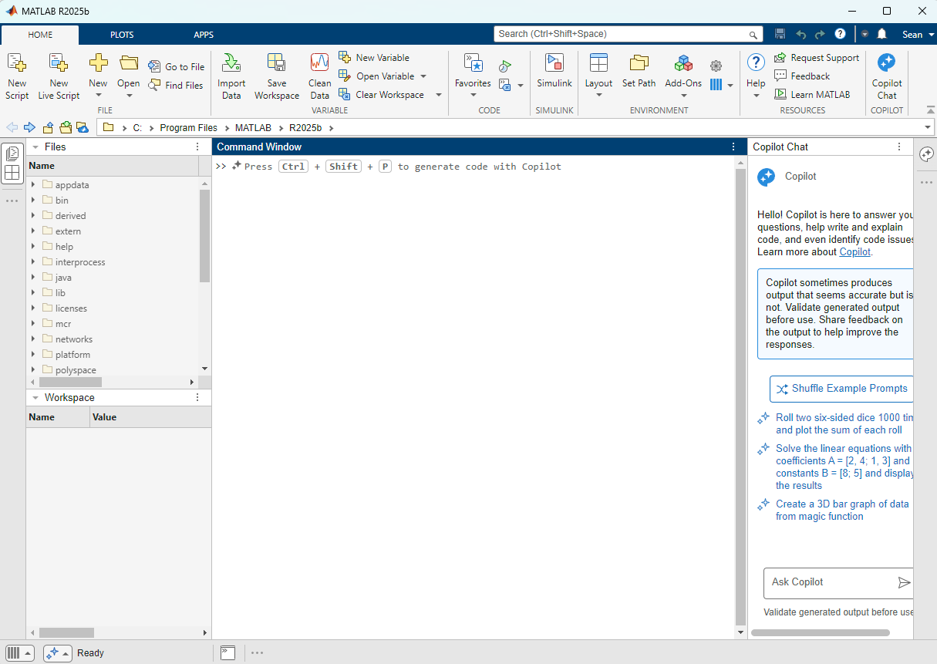
On the computer (NOT your phone)
Click on the Cloud Icon.
It’s the folder with the lightning cloud in the bottom right.
NOTE: I had to install bug updates for mine to show up in 2025b

Slide 10
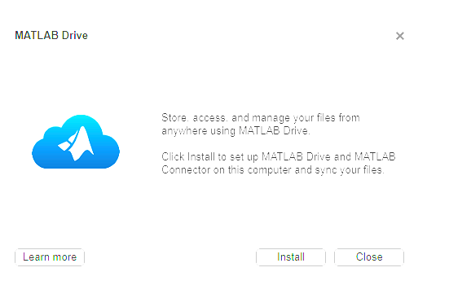
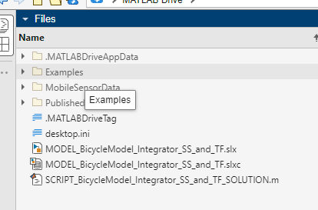
It may ask you to install. Once it is working, you should be able to see folders that contain your MobileSensorData

Slide 11
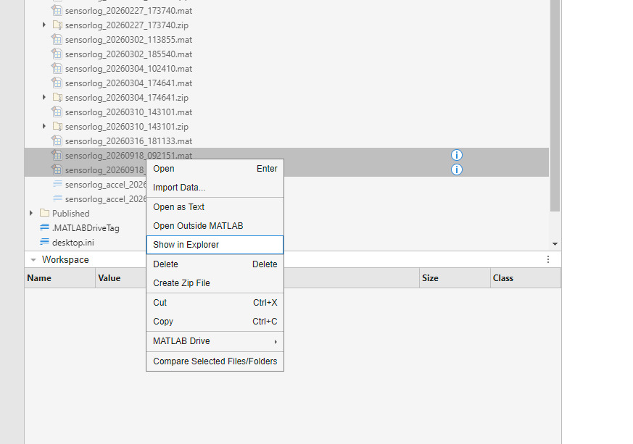
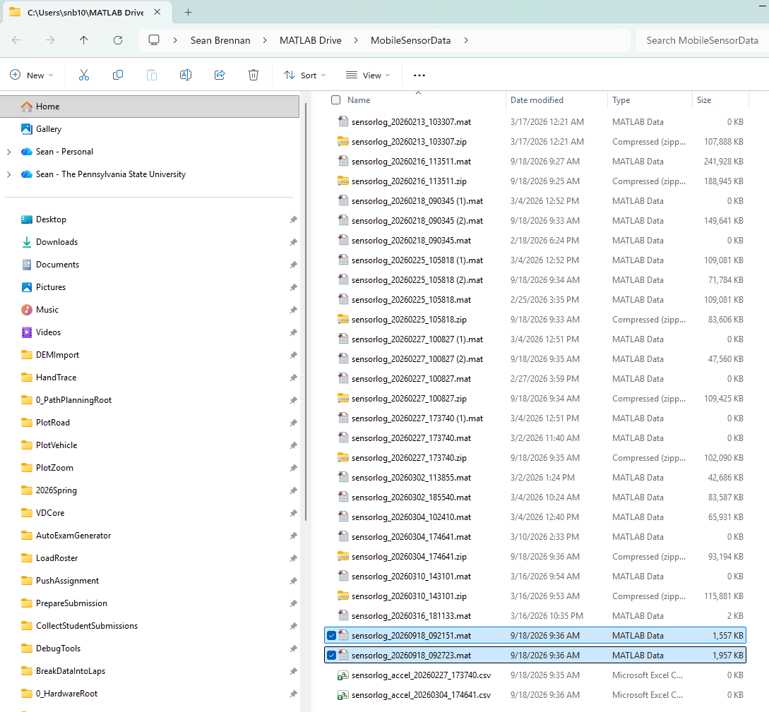
Select the log files, and then left-click to “Show in Explorer” to see where they are on your computer. Move these to your homework folder

Slide 12
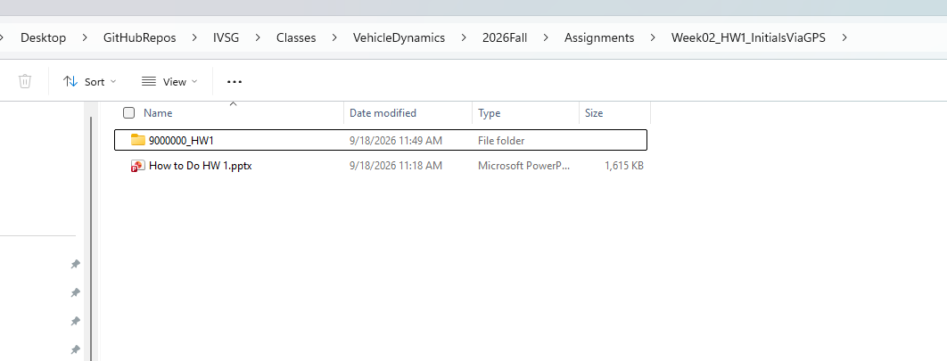
Suggest that your HW be kept in a subfolder with your CanvasID and HW1 in the name. See below for Dr. B (9000000)

Slide 13
Plot the data

Slide 14
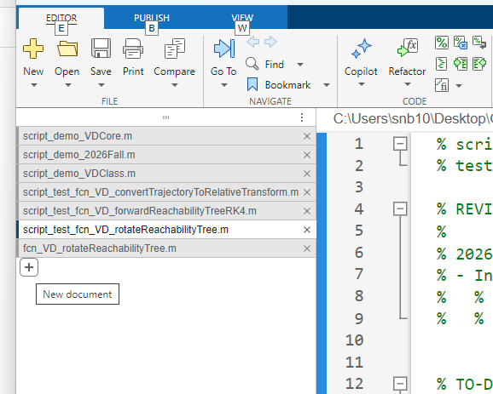
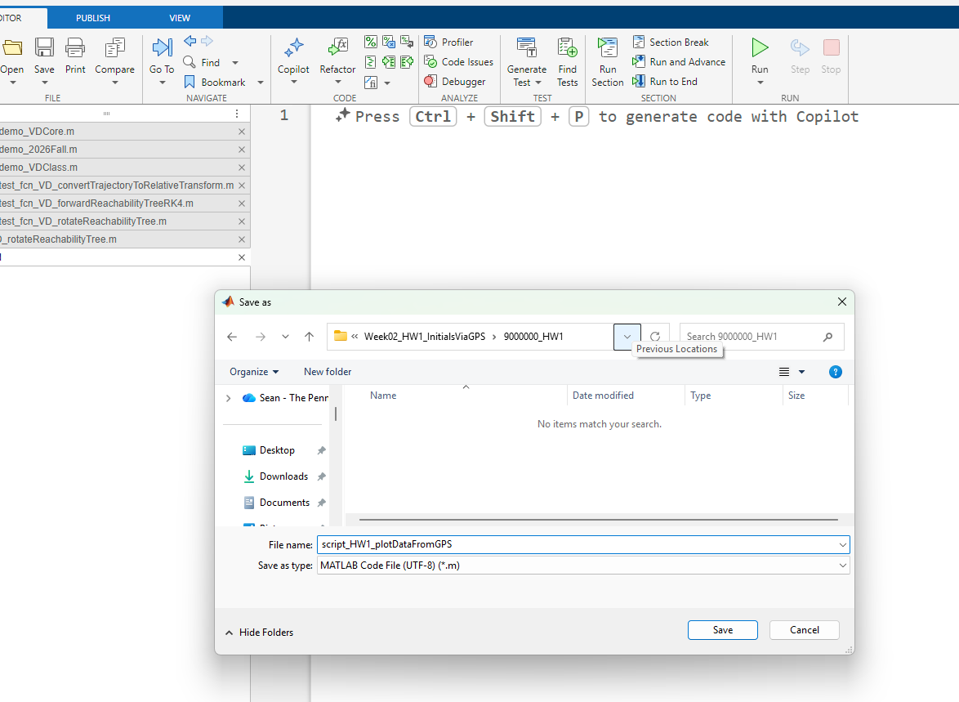
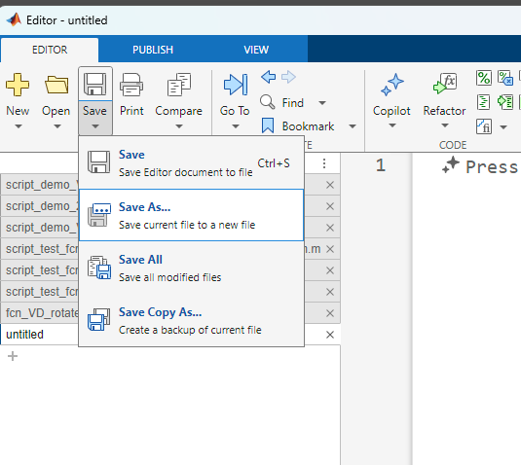
Next, load the data using a script. Make a new file in the editor, save it as a script in your HW folder

Slide 15
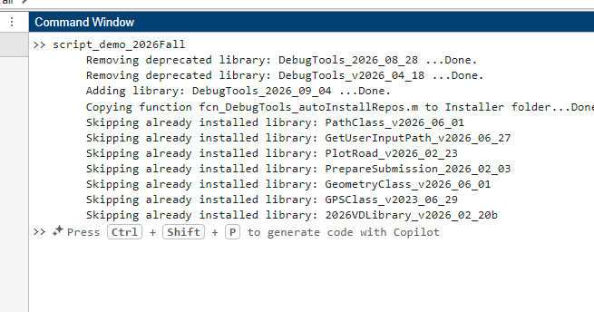
Make sure to run the “script_demo_2026Fall” code here. This will force MATLAB to add your homework folder to its working path

Slide 16
Edit the script to load the files of data (use your own file names)
The first part of the script loads the file names
%% Set the file names
% Specify the folder and file names associated with the data. Edit these
% names to match your folder structure. Note: the PWD command returns the
% path up to and including the 2026Fall directory.
dataStorageFolder = fullfile(pwd,'Assignments','Week02_HW1_InitialsViaGPS','9000000_HW1');
% Make sure the variable isn't used yet
clear filesToLoad
% There are several ways to load data, either automatically or hard-coded.
% The if statement shows both
if 1==1
matFilesInFolder = dir(fullfile(dataStorageFolder,'*.mat'));
for ith_file = 1:length(matFilesInFolder)
% Copy the name string into our list
filesToLoad{ith_file} = matFilesInFolder(ith_file).name; %#ok<SAGROW>
end
else
% Change the names below to match your data. Add more files if needed to
% fill in the 3rd, 4th, etc. entries.
filesToLoad{1} = 'sensorlog_20260918_092151.mat';
filesToLoad{2} = 'sensorlog_20260918_092723.mat';
end
Nfiles = length(filesToLoad);

Slide 17
The second part of the script loads the data
%% Load the data
% Make sure variables are cleared before filling them, to avoid using old
% data accidentally
clear positionsAndSpeeds
positionsAndSpeeds = [];
% Loop through all the files, loading data
for ith_file = 1:Nfiles
  % % NOTE: the variables within each file can be seen by running the following
  % % command:
  % info = whos('-file', filesToLoad{ith_file});
  thisPositionDataTable = load(filesToLoad{ith_file},'Position');
  thisLatitude = thisPositionDataTable.Position.latitude;
  thisLongitude = thisPositionDataTable.Position.longitude;
  thisSpeed = thisPositionDataTable.Position.speed;
  positionsAndSpeeds = [positionsAndSpeeds; thisLatitude thisLongitude thisSpeed]; %#ok<AGROW>
  % If this is NOT the last file, add NaN values between the data so that
  % the data will plot with gaps. NaN forces the "drawing pen" to "lift"
  % when plotting data to disconnect parts of data from each other. We
  % fill in a row of NaN values by simply multiplying the first row by
  % NaN and appending it to the end.
  if ith_file<Nfiles
  positionsAndSpeeds = [positionsAndSpeeds; nan*positionsAndSpeeds(1,:)]; %#ok<AGROW>
  end
end
The data is kept in an array

Slide 18
The third and fourth sections plot the data
%% Plot the positions, colored by speeds
% Type "edit script_test_fcn_plotRoad_plotLLI" to see a script that shows
% how the function below is used.
LLIdata = positionsAndSpeeds(:,1:3);
figNum = 2222; % Set an arbitrary figure number
figure(figNum); clf; % Clear the figure
clear plotFormat
plotFormat.LineStyle = 'none';
plotFormat.LineWidth = 3;
plotFormat.Marker = '.';
plotFormat.MarkerSize = 5;
colorMapString = 'turbo';
% Reduce the colormap
Ncolors = 10;
colorMapMatrix = colormap(colorMapString);
reducedColorMap = fcn_plotRoad_reduceColorMap(colorMapMatrix, Ncolors, -1);
% Specify the sizes (must be same size as reducedColorMap)
markerSizeMatrix = 2*(1:Ncolors)';
plotFormat.MarkerSize = markerSizeMatrix;
[h_plot, indiciesInEachPlot] = fcn_plotRoad_plotLLI(LLIdata, (plotFormat), (reducedColorMap), (figNum));
h_colorbar = colorbar;
h_colorbar.Ticks = linspace(0, 1, Ncolors) ; %Create ticks from zero to 1
% There are 2.23694 mph in 1 m/s
velocity = positionsAndSpeeds(:,3);
colorbarValues = round(2.23694 * linspace(min(velocity), max(velocity), Ncolors));
h_colorbar.TickLabels = num2cell(colorbarValues) ;
h_colorbar.Label.String = 'Speed (mph)';
%% Plot the position data
% Type "edit script_test_fcn_plotRoad_plotLL" to see a script that shows
% how the function below is used.
clear plotFormat
plotFormat.Color = [0 1 1];
plotFormat.Marker = '.';
plotFormat.MarkerSize = 50;
plotFormat.LineStyle = '-';
plotFormat.LineWidth = 3;
figNum = 1111; % Set an arbitrary figure number
figure(figNum); clf; % Clear the figure
% Plot the data into the figure
fcn_plotRoad_plotLL(positionsAndSpeeds(:,1:2), plotFormat, figNum);

Slide 19
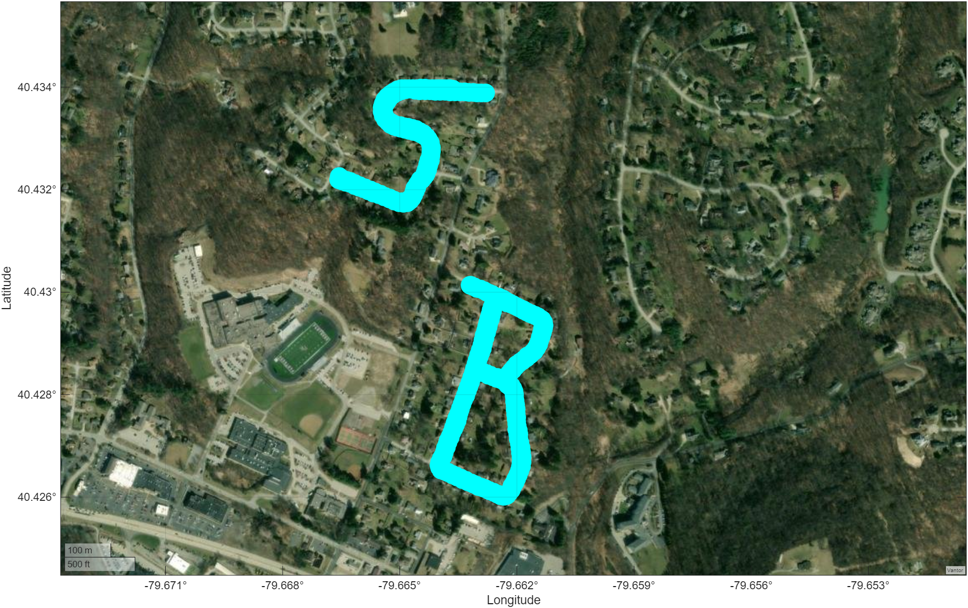
We use the PlotRoad library to do the plotting

Slide 20
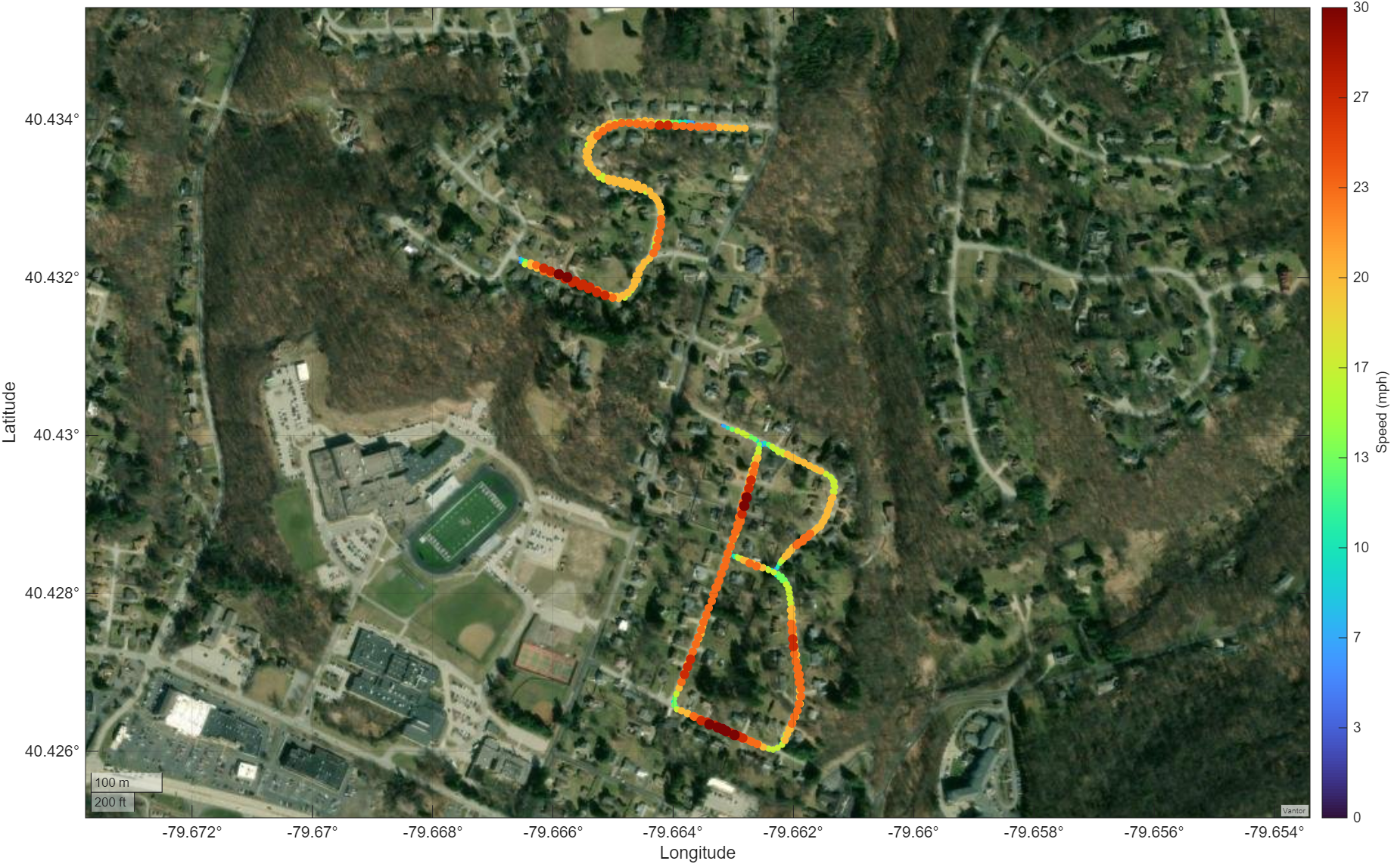
We can also colorize data by speed

Slide 21
Note: MATLAB has a more complicated example online
See: https://www.mathworks.com/help/matlabmobile/ug/acquire-gps-data-and-plot-your-location-and-speed-on-a-map.html

